Slide 1


BROWN DWARFS AND STARFISH.
Isabela Huckabee, Aishwarya Iyer, Michael Line
Arizona State University
Arizona/NASA Space Grant Consortium Symposium 2022

Slide 2
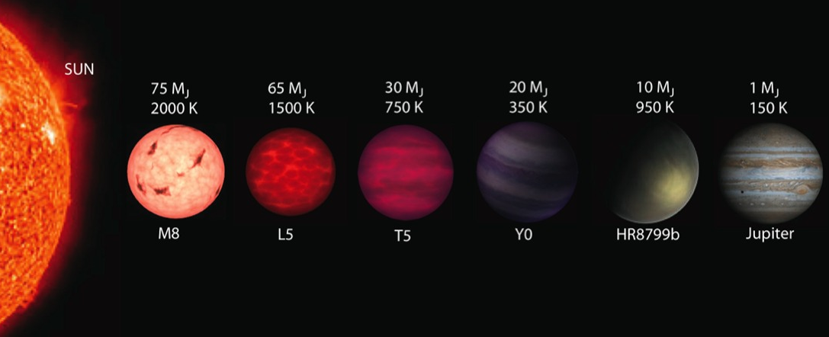
Modified from Mainzer et al. 2009

Slide 3
Putting it all together
Temperature
Carbon to Oxygen Ratio
Surface Gravity
Vertical Mixing
Metallicity
Notes:
including logkzz, CtoO
-brown dwarfs analogs for hot jupiters, CtoO lets us know stuff about formation
-refining condensate chemistry
CH4 vs CO – CtoO stuff, looking specific at these (rather than a bulk metallicity variance)
- dominated by molecular stuff rather than H, He

Slide 4
Putting it all together
Carbon to Oxygen Ratio
Temperature
CH4 vs CO content, formation
Surface Gravity
Metallicity
Vertical Mixing
Disequilibrium chemistry (logKzz)
Notes:
including logkzz, CtoO
-brown dwarfs analogs for hot jupiters, CtoO lets us know stuff about formation
-refining condensate chemistry
CH4 vs CO – CtoO stuff, looking specific at these (rather than a bulk metallicity variance)
- dominated by molecular stuff rather than H, He

Slide 5




Model + Error Overview
Model Interpolation
Correlation between data points
1D stellar atmosphere model
Radiative transfer, convection, equilibrium and disequilibrium chemistry
fudge factor

Slide 6
Starfish: Sources of Error
Interpolation
Noise
Global
Via total reconstruction of model grid
Noise in data caused by random systematics
Model systematics, wavelength correlated data-model residuals
Interpolation + Noise + Global = Fancy Error Covariance Matrix
Czekala et al. 2015

Slide 7
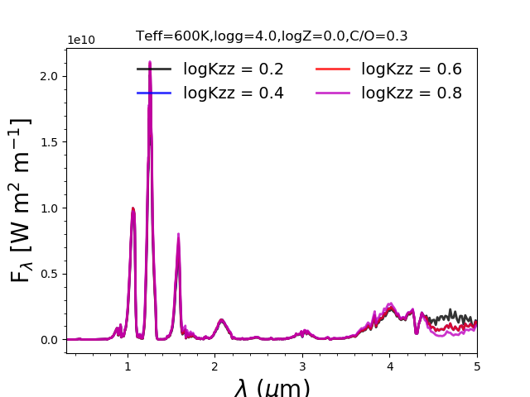
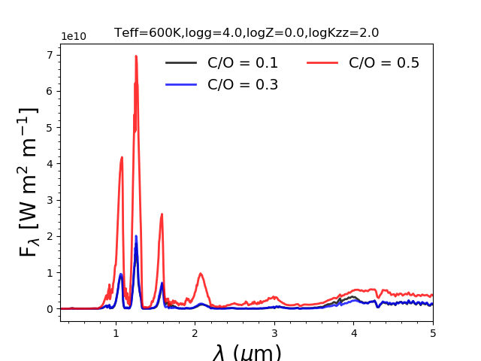
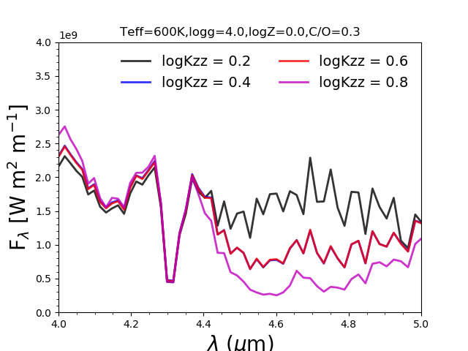
C/O
logKzz

Slide 8
What’s Next?
Compare traditional fit to Starfish fit
Clouds? Disequilibrium? Both?
T-dwarfs: test bed for disequilibrium
Low gravity M-dwarfs: test bed for clouds
Notes:
T-dwarfs: cloud free, just disequilibrium
M-dwarfs: clouds, no disequilibrium
Two ends of brown dwarf class
Avoid degeneracies, figuring them out in an easier way
Low grav cloudy mdwarfs behave like Ldwarfs
M-dwarfs are test bed for clouds
Otherwise in between, you have degeneracies

Slide 9
Questions?
Thank you to my mentors Aishwarya Iyer and Michael Line, as well as the AZ/NASA Space Grant Program and ASU’s School of Earth and Space Exploration
ihuckabe@asu.edu

